Slide 1
Hiretual
Case Competition
Hungry Terps:
Captain: Nai-jieh Wang
Group Member: Jingsi Xu
Ziyi Cheng
Mengyuan Tian
Guiran Niu
Xiaojie Xiao

Slide 2
CONTENTS
Execution Summary
Valuable Insights
Gains and thoughts
Q&A Time

Slide 3
PART 01
Execution Summary
Project Goal
Data Processing

Slide 4
Project Goal
Extraction
Finding patterns
Making analysis &predictions

Slide 5
Data Processing
1
2
Data Cleaning
Data Modeling
1.Missing data
2. Data shifting
3.Missing values
Logistic regression
Linear regression
Regression Tree
Boosting

Slide 6
PART 02
Valuable Insights

Slide 7
Question 1
Extract the most important features and factors that makes a person or a group of people leave a current job for new job.
Logistic Regression
Regression Tress
Boosting

Slide 8
Logistic Regression
Notes:
Jason

Slide 9
Most Influence:
Job_Day
experience
titleexecutive
Accuracy: 59.8%

Slide 10
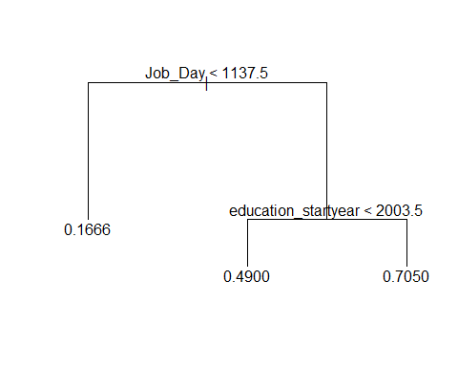
Regression Tree
Most Influence:
Job_Day
education_startyear
Accuracy: 65.4%

Slide 11
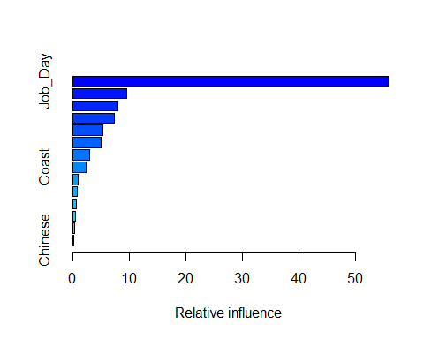
Boosting
Most Influence:
Job_Day
education_endyear
education_startyear
Accuracy: 77.5%

Slide 12
Question 2
Predict the possibility that a person leaves current job to get a new job today, in six months, in a year.
Logistic Regression

Slide 13

Modeling Process
1. Goal:
3. Dependent Variable:
To predict the possibility that a person leaves current job to get a new job:
TODAT
IN 6 MONTHS
IN 1 YEAR
Calculate the date difference between a position’s end date and this person’s next new job start date.
2. Assumption:
4. Logistic Regression
To simplify, the situation that a person is having multiple jobs in a period is not considered here.
Users can perform presentations on projectors or computers and print presentations

Slide 14
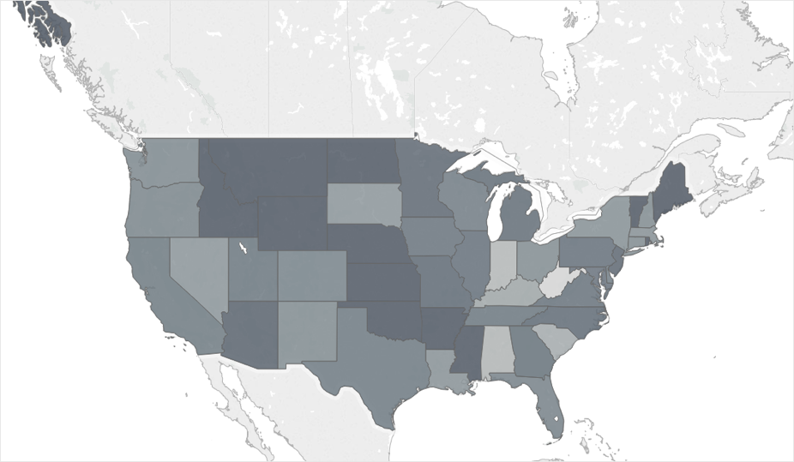
Findings
Person leaves current job to get a new job IN A YEAR
Mid Coast

Slide 15
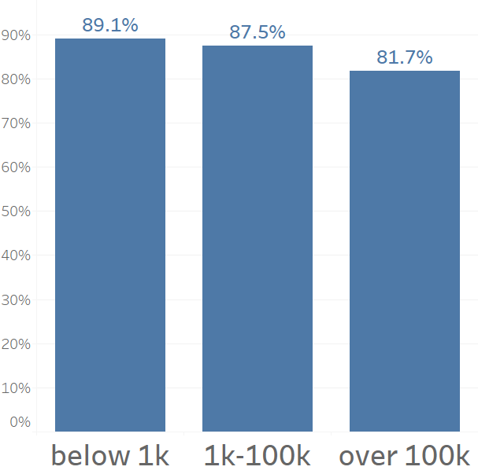
Findings
Person leaves current job to get a new job IN A YEAR
Company Size

Slide 16
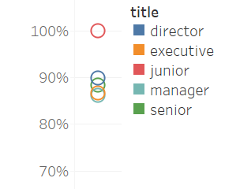
Findings
Person leaves current job to get a new job IN A YEAR
Junior Title

Slide 17
Question 3
Predict the possibility that a person leaves current job before and after anniversary.
Logistic Regression

Slide 18
Recoding & Modeling
Working Duration = Position_EndDate – Position _StartDate
Job_Day(Duration)%% 365 days > 180days, “before_anniversary”=1.
Before_annivary = position_company_size + Chinese + Hindi + English + Spanish + experience + Coast + tit + Job_Day + career + degree
Otherwise, ”before_anniversary = 0”.

Slide 19
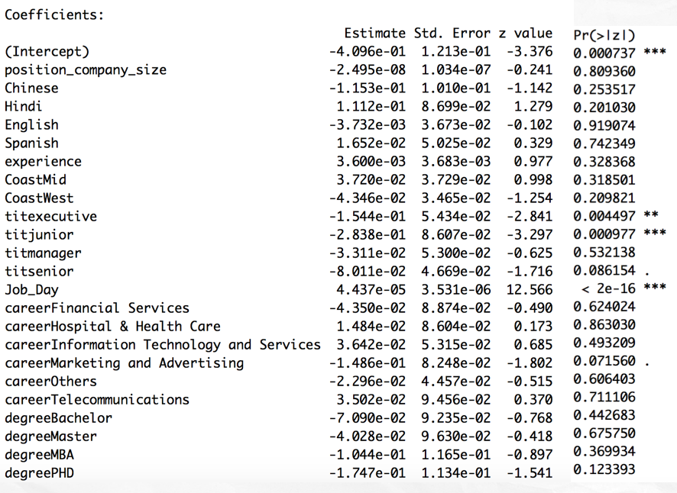
Logistic Regression
Job Title: Executive
Junior
Job_day: working duration
Accuracy: 60%

Slide 20
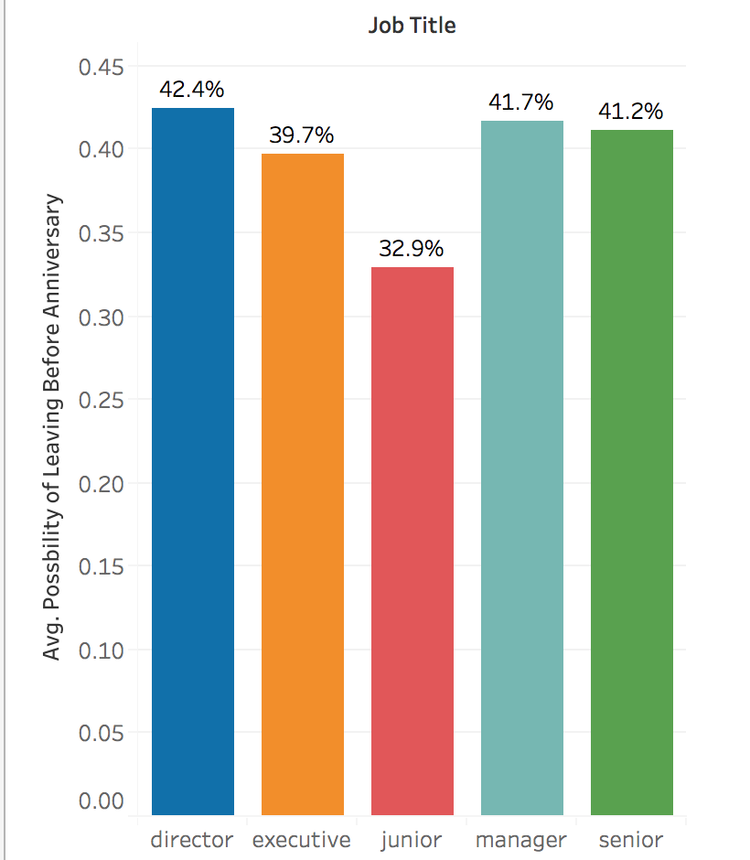
Results
More working days
More like to leave
before anniversary
2. Director
≈ Manager
≈ Senior
> Executive > Junior
Notes:
The longer a person works for a company, he or she is more likely to leave before work anniversary.
A person working as a director is more likely to leave before anniversary than executives and juniors, but managers and seniors are not significant different with directors.

Slide 21
Predictions
Person | Job Day | Coast | Language | Career | Experience | Title | Degree | Prediction
1 | 3179 | East | English | Information Technology and Services | 15 | manager | Master | 43%
2 | 40442 | East | Others | Information Technology and Services | 15 | senior | Bachelor | 79%
3 | 40353 | West | Others | Computer Software | 15 | director | Bachelor | 79%
4 | 1990 | East | Others | Others | 5 | manager | Bachelor | 40%
5 | 1961 | East | Others | Information Technology and Services | 5 | junior | Bachelor | 35%
Notes:
Jason

Slide 22
Question 4
Predict the shortest time and average time until that the person will no longer be at their current job.
Linear Regression

Slide 23
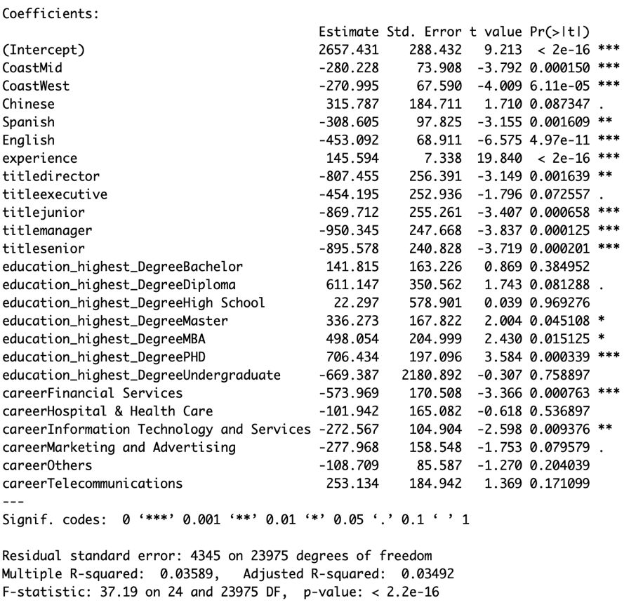
Predict how long a talent will leave current job
Linear Regression
Model Selection: backward
Model:
formula = Job_Day ~ Coast + Chinese + Spanish + English +
experience + title + education_highest_Degree + career, data = train,
na.action = na.omit)
Findings:
Who stay more time at current job?
Experienced;
Hold PhD degree
Who stay less time at current job?
Live at west coast and in the middle areas;
Speak English;
Work in financial services field

Slide 24
Question 5
A person is going to smaller or bigger company
Logistic Regression
Boosting

Slide 25
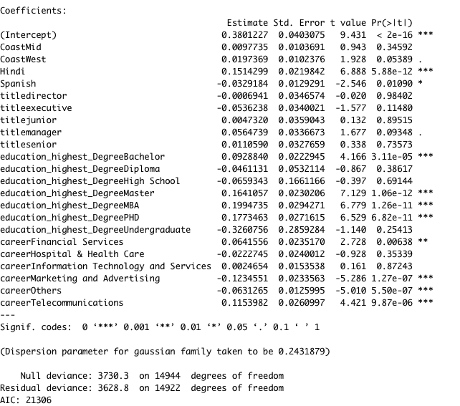
Logistic Regression
Independent Variables:
Coast
Hindi
Spanish
Title
Education Highest Degree
Career
Accuracy:
Full Model: 57%
Selected Model: 56.7%
Notes:
Jason

Slide 26
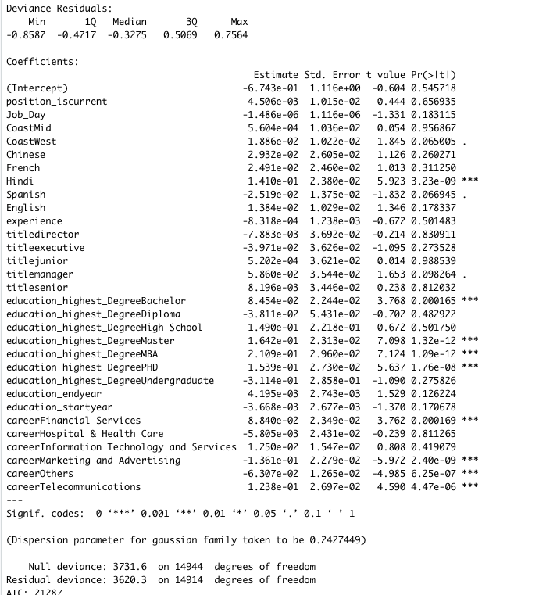
Logistic Regression
for Q5
Notes:
Jason

Slide 27
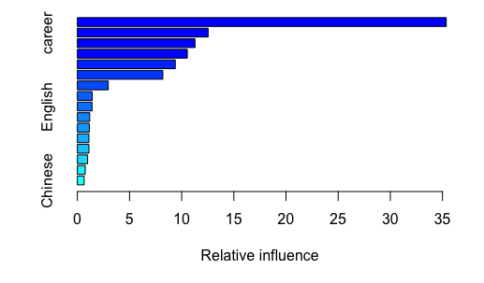
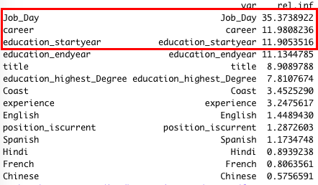
Boosting
Accuracy:
59.2%

Slide 28
Example
A person who is:
- Working days for current job is 3179
Speak English
At East
Information Technology & Services
Master
Education Start Year:1996
Education End Year:1998
53.56% works for larger company

Slide 29
Bonus 1
Predict the possibility that a person willing to relocate to a different location.
Logistic Regression

Slide 30
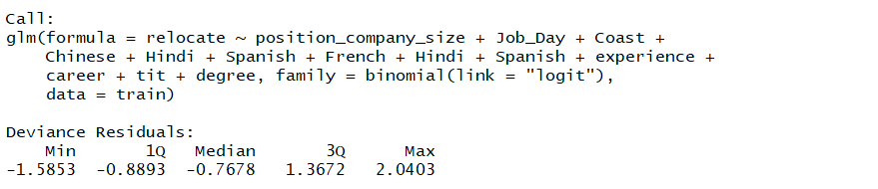
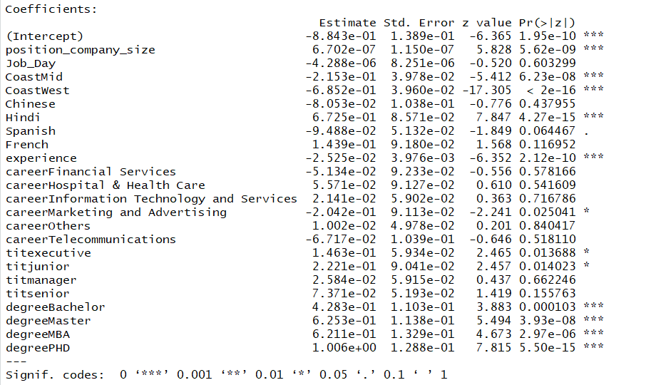
Results
Predict the possibility that a person is willing to relocate
AIC: 24406

Slide 31
Findings
larger size company
less work experience
Marketing and Advertising career path
Executive or Junior

Slide 32
Predictions
Person | Job Day | Coast | Companysize | Career | Experience | Title | Degree | Possibility to relocate
1 | 3179 | East | 597758 | Information Technology and Services | 15 | manager | Master | 45%
2 | 40442 | East | 0 | Information Technology and Services | 15 | senior | Bachelor | 29%
3 | 40353 | West | 4235 | Computer Software | 15 | director | Bachelor | 15%
4 | 1990 | East | 1040 | Others | 5 | manager | Bachelor | 36%
5 | 1961 | East | 85 | Information Technology and Services | 5 | junior | Bachelor | 41%
Notes:
Jason

Slide 33
PART 03
Gains and thoughts

Slide 34
Gains and Thoughts

Slide 35
PART 04
Q&A Time

Slide 36
Q&A

Slide 37
THANK YOU
Thank your to watch

